Slide 1
Case #PC25-06
Consideration of Residential Zoning Districts

Slide 2
Council Direction: Residential Zoning Districts Review
City Council directed Planning Commission to consider the restoration of residential zoning districts and make a report back to City Council on it.

Slide 3
Consultant Discussion: McBride Dale Clarion (MDC)
Planning staff discussed the topic with MDC and what information would be necessary to present to Planning Commission.
MDC agreed to the preparation of a memo reviewing Plan Clayton, summarizing the latest Planning and Zoning Code updates, and presenting options for how to proceed with residential district revisions.

Slide 4
Plan Clayton Comprehensive Land Use Plan and Residential Zoning Districts Evaluation – Introduction
Memo summarizes:
Plan Clayton (Land Use Plan)
Planning and Zoning Code (overview of Residential Zoning Districts)
Options to proceed

Slide 5
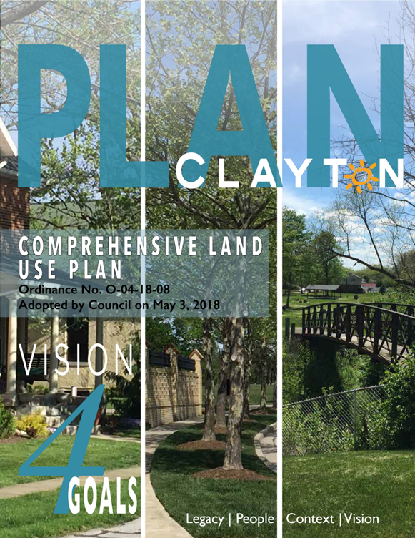
Plan Clayton

Slide 6
Plan Clayton Comprehensive Land Use Plan and Implementation Plan
Key Evaluation Questions
Why was the plan necessary?
What was the timeline that led to its adoption?
What are the qualifications and experience of the lead planning consultant, Urban Collaborative?
What primary changes occurred to Clayton’s land use?
Planning Commission Requests
How does the plan address urban sprawl, school and education facility needs, and alignment with planning best practices?

Slide 7
Plan Clayton Facts
Typically, land use plans are fully updated every 10 to 20 years, with incremental updates every 5 years; this is widely considered a best practice of the planning profession. The city began the process of updating the plan in 2016 by identifying a Comprehensive Land Use Plan update in the 2016 Five-Year Economic Plan.
City Staff completed the first step by selecting three specific areas for development: the Village of North Clayton, Salem Avenue Business Corridor, and Main Street Business Corridor. The second step called for the creation of a Land Use Plan update as well as a Main Street Overlay District.

Slide 8
Plan Clayton Facts and The Urban Collaborative (Land Use Consultant)
Adopted May 3, 2018 (Ord. O-04-18-08).
The plan was a collaborative effort of Clayton staff, The Urban Collective (Consultant), and Trans Systems.
The Urban Collaborative is an interdisciplinary design firm which develops land use plans.
Urban Collaborative’s land use plans are widely recognized for their participatory development approach and strong focus on sustainability. Their interdisciplinary team of architects and planners demonstrated the necessary experience to successfully carry out the Comprehensive Land Use Plan update.

Slide 9
Plan Clayton Facts
Plan Clayton was needed to respond to changing trends and development pressures. Growth is directed around the town center, on Main Street, and in selected surrounding areas.
At the beginning of the document there is a letter from the Mayor and City Council and the final statement reads: “The City Council fully supports this plan, and we encourage the entire community to embrace it as well.” Currently 6 of the original 7 members who signed the above statement, including the Mayor, are elected officials today.
The former Director of Development provided a statement within the plan that “increasing our tax base benefits the City as a whole.” This indicates that part of the effort of the planning document was to encourage the overall growth of the city but doing so in an orderly manner with controlled growth.

Slide 10
Key Themes – continued from 1999 Land Use Plan
Enhance Multi-modal Opportunities (walking and biking)
Consider Environmental Impacts
Reduce Sprawl
Maximize Infrastructure
Improve Quality of Life
The continuation of these themes from 1999 to the adoption of Plan Clayton in 2018 shows that the city was committing to similar principles and this plan update was not entirely different from ideas around growth at the city’s inception (1998).

Slide 11
Engagement
Engagement for the plan was extensive – including interviews, surveys, work sessions, and workshops. There were many opportunities for the public to get involved in the process and guide planning efforts. Key engagement numbers are as follows:
36 Interviews
216 Survey responses
12 public work sessions
4 days of workshops – 55 participants
15 participants attended the site analysis walk
76 stakeholders (Page 108)

Slide 12
Engagement – MDC Comparison
The level of engagement and number of participation opportunities in Clayton’s process are comparable to similar projects MDC has been involved with.
For example, the City of Franklin Downtown Master Plan (Franklin, Ohio), adopted in 2023, included over 380 survey responses and 40+ attendees at open houses. The one-year planning process also featured Council Retreats, a Citizens Advisory Committee meeting, and visual preference exercises.
While the survey responses for Plan Clayton represent about 1.6% of Clayton’s 2018 population (approximately 13,000), this rate of participation aligns well with current professional practice.
The number of interviews exceeds that of a recent Comprehensive Plan update MDC completed in Miami County, Ohio (13 total interviews compared to the 36 in Plan Clayton). These interviews included “City Council and Board members, City Staff, Members of the Northmont School Board, Clayton Business owners, interested residents, the Miami Valley Regional Planning Commission, and the Dayton Development Coalition” (Plan Clayton, Page 21).

Slide 13
Future Land Use Map Analysis
Observations from the 1999 Future Land Use Map and The New Regulating Plan (Future Land Use Map from Plan Clayton) – this is to help explain what changed during the 20-year update.

Slide 14

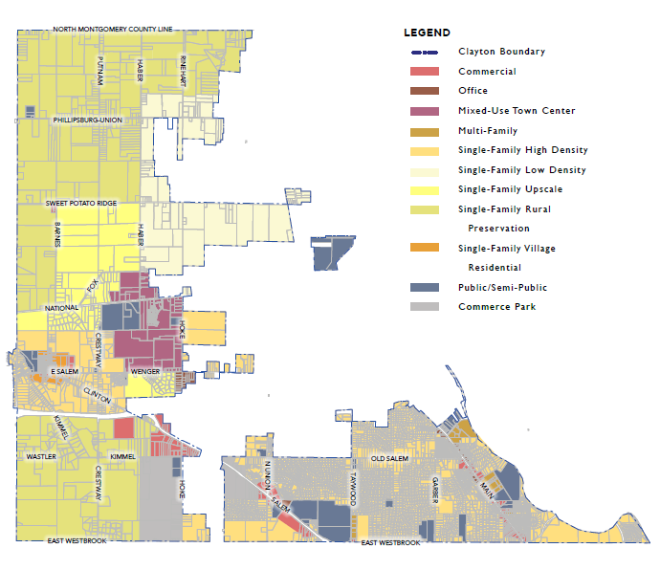



Future Land Use Map (1999)

Slide 15
Key features of the 1999 Future Land Use Map include:
Mixed Use Town Center at National / Haber
Single-Family Low Density and Single-Family Upscale surrounding the Mixed-Use Town Center
Single-Family High Density surrounding the Single-Family Village Residential
Commercial and Office uses concentrated on Clinton/Salem and Main Streets

Slide 16
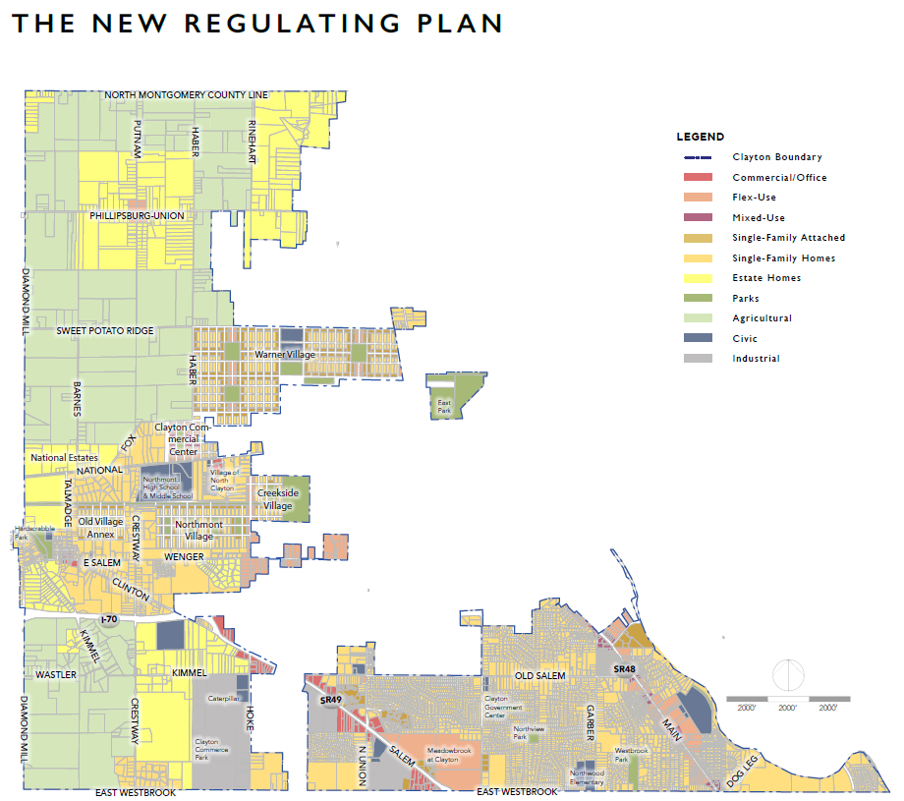
The New Regulating Plan (2018)

Slide 17
Key features of the New Regulating Plan (Future Land Use Map):
Consistent with the 1999 Future Land Use Plan, a mixed-use town center is centralized around National and Haber.
Commercial / Office uses are located just north of the Caterpillar Commerce Park on the old plan, and those were replaced by “Estate Homes” in the update.
The New Regulating Plan provides additional guidance on the preferred form of future development, especially in residential areas. Introduction of attached housing types, dedicated park space, etc.

Slide 18
Key features of the New Regulating Plan (Future Land Use Map):
The largest difference between this plan and the 1999 Land Use Plan is the addition of Warner Village east of Haber Road.
The New Regulating Plan specifies attached housing types as a key feature of future development along with “Flex-Use”: a combination of commercial, office, and residential uses in one area or in the same building. Flex Use is shown to anchor the central nodes of Warner Village and other proposed village centers flanking the north and south sides of National Road.
Another notable change is the conversion of hundreds of acres from “Single Family Rural Preservation” and “Single Family Low Density” in the 1999 Plan to “Agricultural” on either side of Haber Road. This indicates an intentional effort was made to preserve agricultural lands while adding the denser Warner Village nearby.

Slide 19
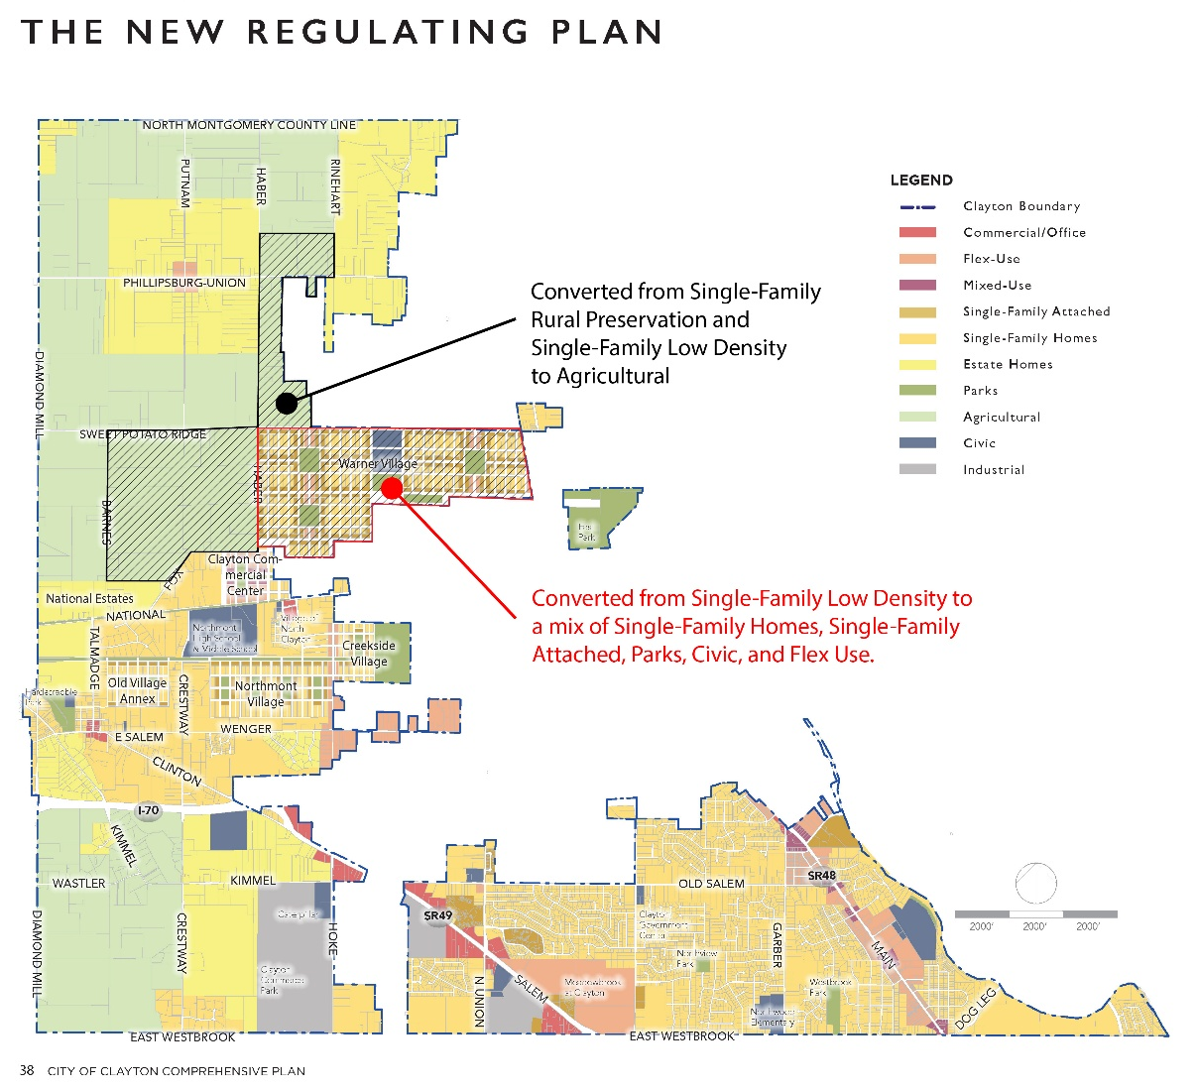
The New Regulating Plan (plus MDC analysis)

Slide 20
Analysis
The Future Land Use Plan is consistent with what we see in current best practices in planning.
The introduction of additional home types promotes a variety of housing types beyond detached single family homes – encouraging growth in key areas and protecting agricultural lands from sprawling development patterns that provide less homes on more land, with more efficient use of infrastructure and other resources.

Slide 21
Approach to Sprawl
The plan confronts sprawl by explicitly preserving agricultural land and restricting dense development in rural areas, which acts as a buffer and maintains community character.
Instead of allowing scattered residential subdivisions, new growth is intended to be concentrated within defined neighborhoods that feature walkable streets, parks, and central cores.
The New Regulating Plan sets standards for mixed housing types, estate homes as rural buffers, and integration of green spaces in all new development zones.
Infill and redevelopment, particularly in existing village cores, are prioritized to revitalize older areas and avoid fringe expansion.
The plan also identifies spot development and the extension of municipal boundaries into rural zones as key challenges needing proactive management.

Slide 22
Schools and Education Facilities
Schools are treated as major community assets in the plan, with frequent references to the Northmont School District and specific facilities such as Northmont High School, Middle School, and Northwood Elementary.
The plan advocates for physical connectivity to schools through trails and sidewalks, integrating them into broader community networks.
While the document inventories school locations and includes school board engagement in its process, it does not provide explicit policies for school siting or future expansion, instead emphasizing their roles as anchors of neighborhood life.

Slide 23
Schools and Education Facilities
Generally, planners take this approach – leaving school capacity, facilities, and operations to the local school boards, which are independent governing bodies with their own taxing authority and decision-making processes.
Local jurisdictions do not have authority over how or where schools are built, expanded, or managed.
Instead, planners focus on identifying where new development makes the most sense to support existing and planned educational facilities. This means coordinating land use, transportation, and infrastructure planning in a way that complements school district decisions, while recognizing that ultimate control over educational facilities rests with the school boards.

Slide 24
Alignment with Best Practices
Clayton’s approach reflects best practices in urban planning by:
Grounding its strategies in thorough public engagement and visioning.
Employing a regulating plan to focus growth within compact, mixed-use neighborhoods while reserving rural land for agricultural use.
Featuring walkability, continuous sidewalks, and street trees as foundations of community design.
Locating parking out of sight to foster vibrant, safe streetscapes within mixed-use central cores.
Providing every resident with quick access to parks or green spaces.
Using growth management tools that balance prescriptive standards with flexible design guidelines.
By integrating these elements – public input, rural preservation, smart land use, walkability, mixed-use zoning, and robust connectivity – the plan strongly conforms to anti-sprawl recommendations and standards endorsed by contemporary planning organizations. Schools are woven into this vision as essential community centers, further supporting principles of cohesive, connected, and healthy neighborhoods.

Slide 25
Planning and Zoning Code Update
Overview of the subsequent changes to the code based on Plan Clayton’s guidance:
Which residential districts were changed? How have they changed?
Provide a graphic map to show the differences between the old map (2013) and the updated map (2018)
Planning Commission additional requests:
Compare permitted densities in new vs. former zoning districts; highlight where the new code allows higher densities
Map all areas where residential densities exceed those allowed in the RSD District
Benchmark the use of RSD or equivalent districts in other communities (e.g., Englewood, Trotwood) and provide case examples

Slide 26
Overview
A complete rewrite of the Clayton Zoning Code was started in 2019, and was approved in mid-2021, providing a much more user-friendly set of regulations that lay out new development standards and zoning regulations consistent with what is laid out in the Plan Clayton document.
One of the more significant changes was the simplification of residential districts. Below are the current residential districts and the associated districts they replaced from the old code.

Slide 27
1101.04 Zoning and Districts (Table)
Districts and Zones | Symbol | Replaces
Zones
Rural Conservation | RCD-1 & RCD-2 | A
Suburban Conservation | SCD | A-1
Residential – Single-Unit | RSD | R-1, R-2, R-3, UR-1
Residential – Multi-Unit Mixed Use | RMX | UR-2, O-R
Planned Development | PDD | PD-1 through PD-4

Slide 28
Old Districts
Residential & Conservation
R-C – Rural Conservation District
R-1 – Open Space Residential District
R-2 – Suburban Residential District
R-3 – Suburban Residential District
UR-1 – Urban Residential District
UR-2 – Urban Residential District
Based on the plan and the associated changes to the zoning code, it appears that there was an attempt to unify the suburban residential districts into a singular “Residential – Single-Unit District” (RSD), with the intent to maintain a consistent character throughout Clayton.

Slide 29
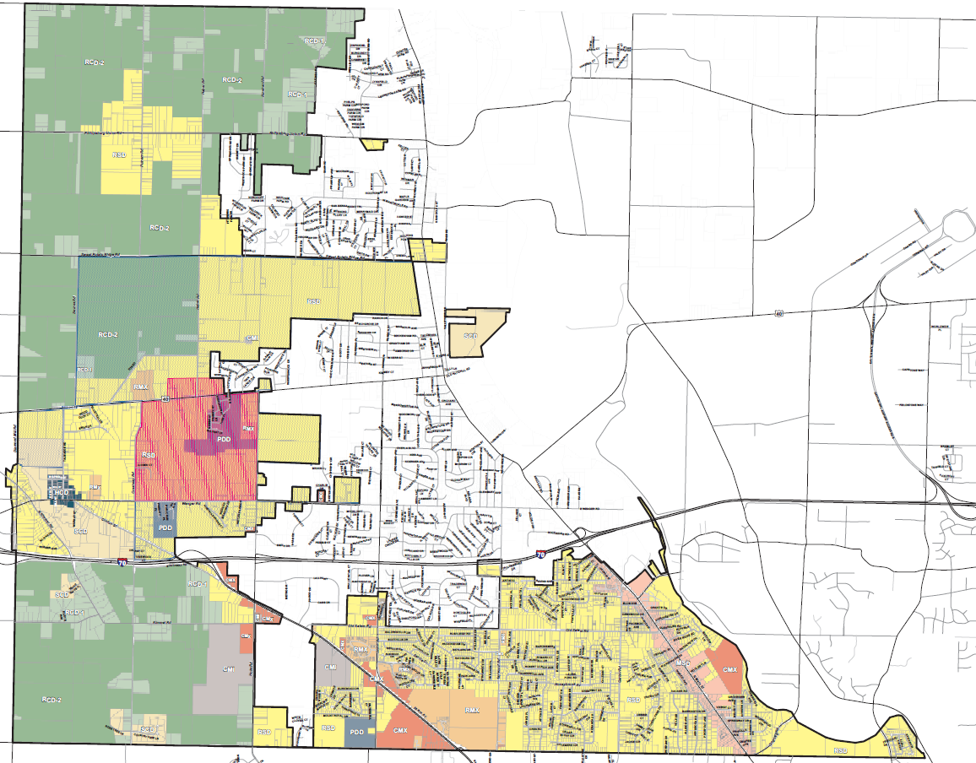
Current Zoning Map
Description (Enlarged version available on the city’s website – image is for reference only)
Larger yellow portions are the RSD District
Green is the RCD-1 and RCD-2

Slide 30
Current and Previous Residential Dimensions Summary Table
Current Residential Dimensions Summary Table
 | RSD | RMX | SCD | RCD-1 | RCD-2
Lot Size | 0.15 acre | 0.25 acre | N/A | N/A | 10 acres
Units Per Acre | N/A | 24 | 1 | N/A | N/A
Lot Size in SF (Approximate) | 6,534 | 10,890 | - | - | 435,600
Previous Residential Dimensions Summary Table
 | UR-1 & UR-2 | R-3 | R-2 | R-1 | R-C
Lot Size in SF | 7,500 SF | 10,000 SF | 15,000 SF | 20,000 SF | 1 Acre
Lot Size in Acres (Approximate) | 0.17 | 0.22 | 0.34 | 0.45 | 1

Slide 31
Summary Table Analysis
The current RSD Zoning District has a minimum lot size of 0.15 acres (approximately 6,500 square feet). This is a smaller lot size that the Urban Residential Districts from the old zoning code (7,500 square feet).
The intention of this code change was likely to increase flexibility and ease formerly stricter minimum lot sizes. It is difficult to understand the full impact on existing lots without a more in-depth analysis of parcel sizes throughout the city.

Slide 32
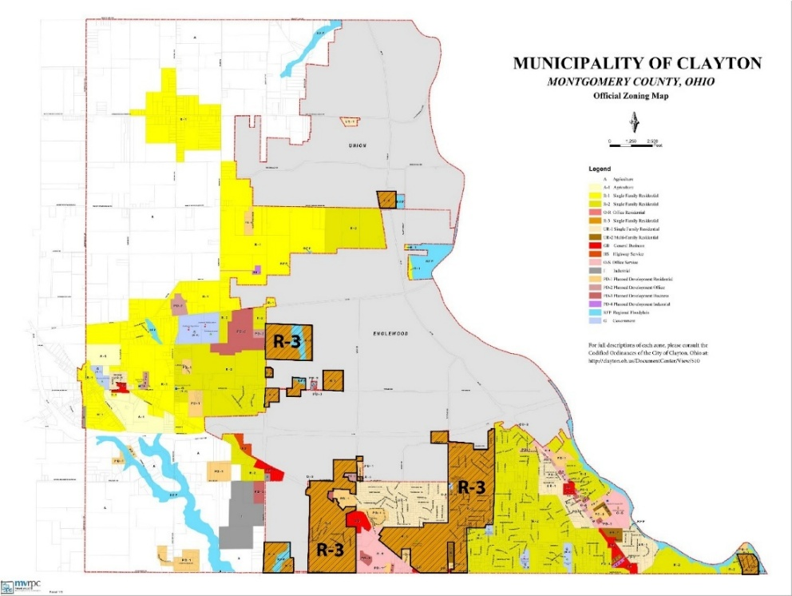
R-3 District Locations | Old Zoning Map (Clayton followed this before 2021 update)
The R-3 District primarily was located on either side of Salem Avenue, with smaller areas along Wenger Road.

Slide 33
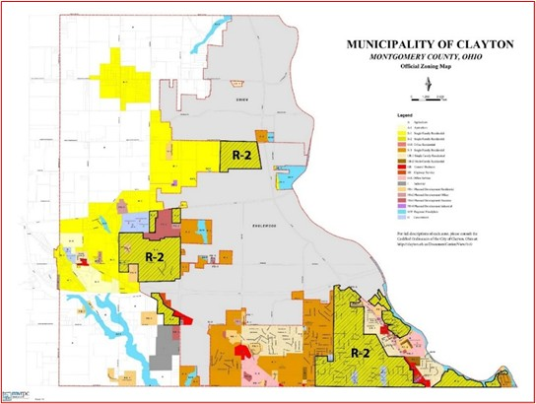
R-2 District Locations | Old Zoning Map
The R-2 District branched into existing urbanized areas near Garber Road and Main Street; it also was located between National Road / I-70 Interstate, and along Sweet Potato Ridge Road.

Slide 34
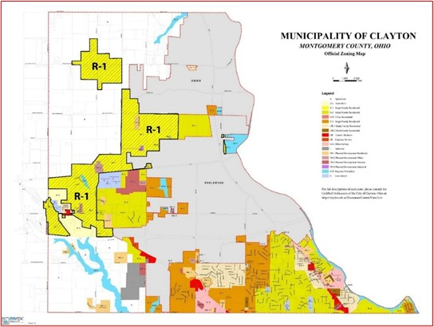
R-1 District Locations | Old Zoning Map
The former R-1 Zoning District was primarily located around the Historic Clayton center and branched east and north into the Agricultural area.

Slide 35
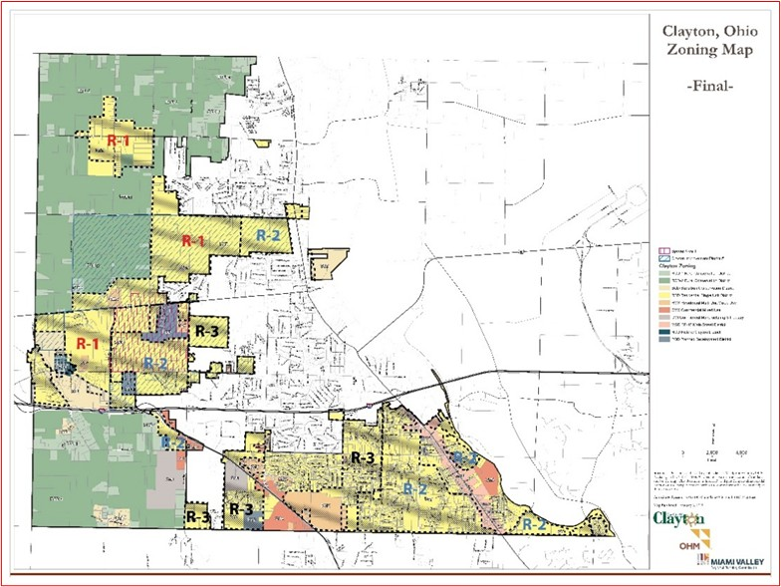
R-1, R-2, and R-3 District Locations on Current Zoning Map
This graphic shows where the old Zoning Districts overlap on today’s official Zoning Map.

Slide 36
Analysis
Consolidating the districts and permitting higher density development across the city is an effective strategy to simplify the development process, allowing for more homes to be constructed, and preserving agricultural land. The changes appear to align with the Comprehensive Plan strategies.

Slide 37
Englewood, Trotwood, and Brookville Equivalents
City of Englewood Title Six – Zoning Code (Section 1262.06)
Equivalents District: R-5 Residential District (last updated in 1990)
Minimum lot size: 8,000 square feet for single family homes, 12,500 square feet for two-family, and 3 acres for multi-family
City of Trotwood Part Eleven – Planning and Zoning Code (Chapter 1145.05)
Equivalent District: Residential Single Family-High Density (RSF-H) (last updated in 1999)
Minimum lot size: 10,000 square feet.
City of Brookville Part Eleven – Planning and Zoning Code (Section 1127.03)
Equivalent District: R-2 Urban Residential District (last updated in 1994)
Minimum lot size: 8,400 square feet
The cities of Englewood, Trotwood, and Brookville are nearby cities in Montgomery County that we looked for comparisons to the RSD Zoning District in Clayton. We found that across the board, minimum lot sizes were higher in their densest residential districts than Clayton.

Slide 38
Analysis
Planned Developments are also options within the zoning codes mentioned. So, while across the board, minimum lot sizes in the base districts are higher in these cities, there is always the option for a developer to negotiate a smaller lot size if they go through the Planned Development process.
Additionally, these cities have not updated their zoning districts in over 20 years – Clayton’s recent code update and changes to create a flexible base residential district are well ahead of the curve and are in alignment with zoning code reform seen across the United States. In our practice, we often find that cities ease restrictions to allow for additional infill and new development – helping the city’s long-term growth.

Slide 39
Options to Proceed
Here are three options for how to proceed with the residential districts based on the information we have presented in this memo. These are intended to be a starting point for conversation.

Slide 40
Option 1 – Maintain Current Zoning Structure.
Continue utilizing the existing land use plan and zoning map to inform zoning decisions and retain the current RSD Residential Zoning District without changes.
Why should the PC consider this option?
This option recognizes that the adopted land use plan was the result of a thorough planning process with strong public engagement and professional guidance.
The plan was formally adopted by the city and reflects the desired framework for how future growth should occur.
The core principles of the plan are to promote dense, walkable neighborhoods, with quick access to parks and schools. Allowing these residential areas to grow in designated areas allows the city to grow in a coordinated manner.
Potential disadvantages:
The consolidated RSD Zoning District may not provide sufficient differentiation between traditional single-family neighborhood types (e.g., lot sizes, setbacks, character)
Limited availability to respond to community preferences for lower- or higher-demand residential development in specific areas.
Could result in unintended development patterns if market pressures or infrastructure constraints vary across previously zoned R-1, R-2, and R-3.

Slide 41
Option 2 – Conduct a Targeted Review of the Land Use Plan and Zoning Code
Undertake a focused analysis of the existing land use plan and zoning code to determine whether adjustments to the Future Land Use Map are warranted – specifically, whether to reintroduce distinctions among low, medium, and high-density single-family areas (formerly R-1 (lowest density), R-2 (medium density), and R-3 (highest density)).
Why should the PC consider this option?
Provides an opportunity to evaluate where lower density single-family housing options may be appropriate or desirable.
Allows the city to verify that the current zoning districts align with community goals, infrastructure capacity, and market trends.
Potential disadvantages
The current plan represents a significant investment of time and resources, including a detailed implementation strategy.
Any revisions to the land use plan would require corresponding updates to the implementation plan, infrastructure planning, and potentially other related documents.

Slide 42
Option 3 – Reinstate Original R-1, R-2, R-3 Districts
Restore the traditional zoning districts (R-1, R-2, and R-3), each with its own dimensional standards and permitted uses. This would involve amending the zoning ordinance, updating the official zoning map, and revising related planning documents and references throughout the code.
Why should the PC consider this option?
Provides clear differentiation among single-family neighborhood types, offering more predictable outcomes for residents and developers.
Aligns zoning more closely with the historic development pattern and neighborhood character residents are familiar with.
May better align with the preferences of homeowners and potential buyers seeking a range of housing options within the community.
Potential disadvantages:
Requires substantial reworking of multiple code sections, remapping of zoning boundaries, and review of existing property entitlements.
May complicate new development proposals and reduce the flexibility achieved through the consolidated RSD district.
May not reflect current development trends and preferences due to rising costs, lifestyle choices, and other priorities.

Slide 43
Questions &
Comments
Planning Commission members are encouraged to ask questions, request clarification, and give input on the information presented.

Slide 44
Helpful
Links
Clayton City Council Meeting: https://www.youtube.com/watch?v=oBpBI93kHCQ (1:30:00 mark)
PLAN Clayton Implementation Plan: https://www.clayton.oh.us/DocumentCenter/View/2746/Clayton-Implementation-Plan_25-Apr-2018
PLAN Clayton Implementation Committee Final Report to Council: https://www.clayton.oh.us/DocumentCenter/View/4775/PLAN-Clayton-Implementation-Committee---Final-Report
PLAN Clayton Comprehensive Land Use Plan: https://www.clayton.oh.us/DocumentCenter/View/2744/Clayton-Comprehensive-Plan_Final
PLAN Clayton Appendix: https://www.clayton.oh.us/DocumentCenter/View/2745/Clayton-Appendix_25-Apr-2018
PLAN Clayton Website: https://www.clayton.oh.us/364/PLAN-Clayton (this site has the meeting videos from 1/13/2021 – 6/16/2021)

